Slide 1
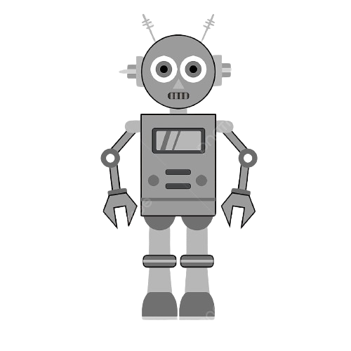
Modern control systems final project report
Self-balancing robot

Slide 2
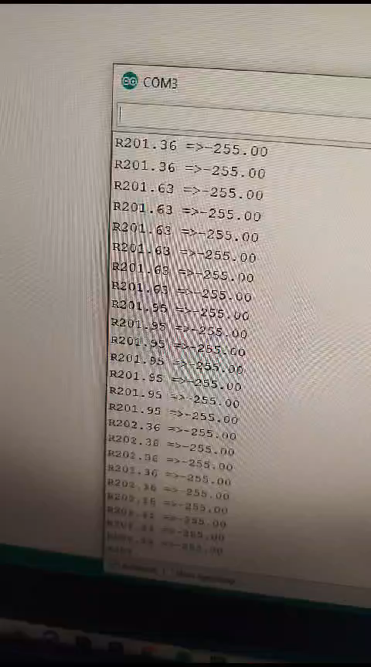
Video for the project:

Slide 3
Team members:
Name | ID
Andrew Botros Ayad | 20201322493
Peter Hany Fayez | 20221441026
Marina George Zarif | 20221443430
Carine Emad Sanad | 20221440878
Seveen Samir Wakim | 2103117
Sandra Wassim Youssef | 20221440830

Slide 4
Introduction
The self-balancing robot project aims to develop a smart robot that can stay upright on its own. It uses advanced sensors like a gyroscope and accelerometer to accurately measure the robot's tilt and acceleration. The robot adjusts its motor speeds in real-time using a control algorithm, a PID controller, to respond dynamically to changes in orientation and maintain stability.

Slide 5
Components used
MPU6050 Sensor
PID Controller (using "PID_v1.h" library)
DC Motors and PWM Control
Kalman Filter
Microcontroller (Arduino Uno)

Slide 6
Sensor calibration:
Calibration Process:
Power-On Initialization
Sensor Initialization
Collect Raw Sensor Data
Stationary Calibration
Offset Identification
Offset Compensation
Fine-Tuning Parameters
• Testing and Validation

Slide 7
Control system design
the self-balancing robot's control system is implemented through a Proportional-Integral-Derivative (PID) controller, designed to continually adjust motor speeds based on the difference between the desired and actual orientation. The three components of the PID controller—Proportional (P), Integral (I), and Derivative (D)— contribute to immediate error correction, elimination of steadystate errors, and damping effects to reduce overshooting, respectively.

Slide 8
Kalman filtering
In the self-balancing robot project, the Kalman filter plays a pivotal role in refining sensor data and enhancing the system's overall performance. This advanced filtering mechanism serves to reduce sensor noise, providing cleaner and more reliable data from both the accelerometer and gyroscope. By combining information from these sensors, the Kalman filter ensures improved accuracy in estimating the robot's orientation, effectively smoothing out erratic readings and minimizing deviations in yaw angle measurements. The chosen parameters for the Kalman filter, including process noise (Q), measurement noise (R), and initial estimate (P), have been thoughtfully selected to balance the filter's sensitivity to changes in the underlying process, the accuracy of sensor measurements, and the initial covariance of the estimation. This calibration contributes to the system's stability, precision in yaw angle measurements, adaptability to environmental changes, and the reduction of gyroscope drift, collectively enhancing the self-balancing robot's capability to maintain equilibrium in various conditions

Slide 9
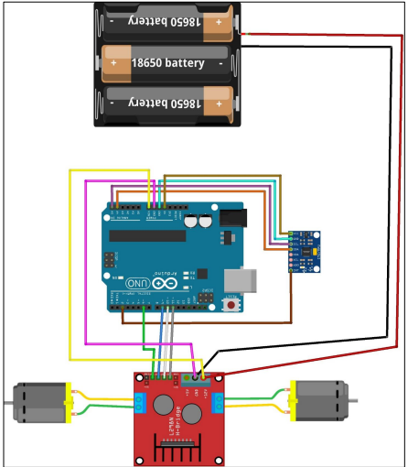
Circuit design

Slide 10
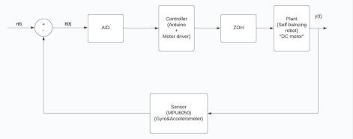
Block diagram:

Slide 11
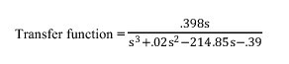
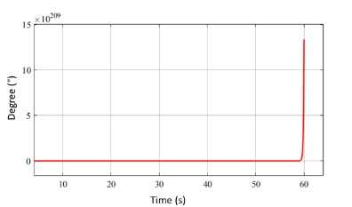
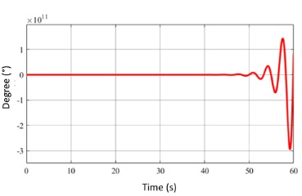
Output: Step response:

Slide 12
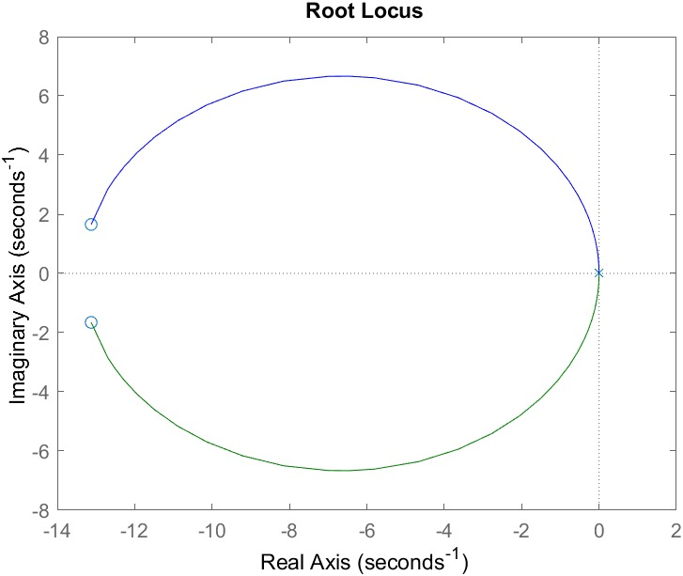
Root locus:

